Slide 1

Coffee Sales Analysis
Insights and Conclusions
Report Date: 12/08/2025
by VAISSER BARUCH

Slide 2
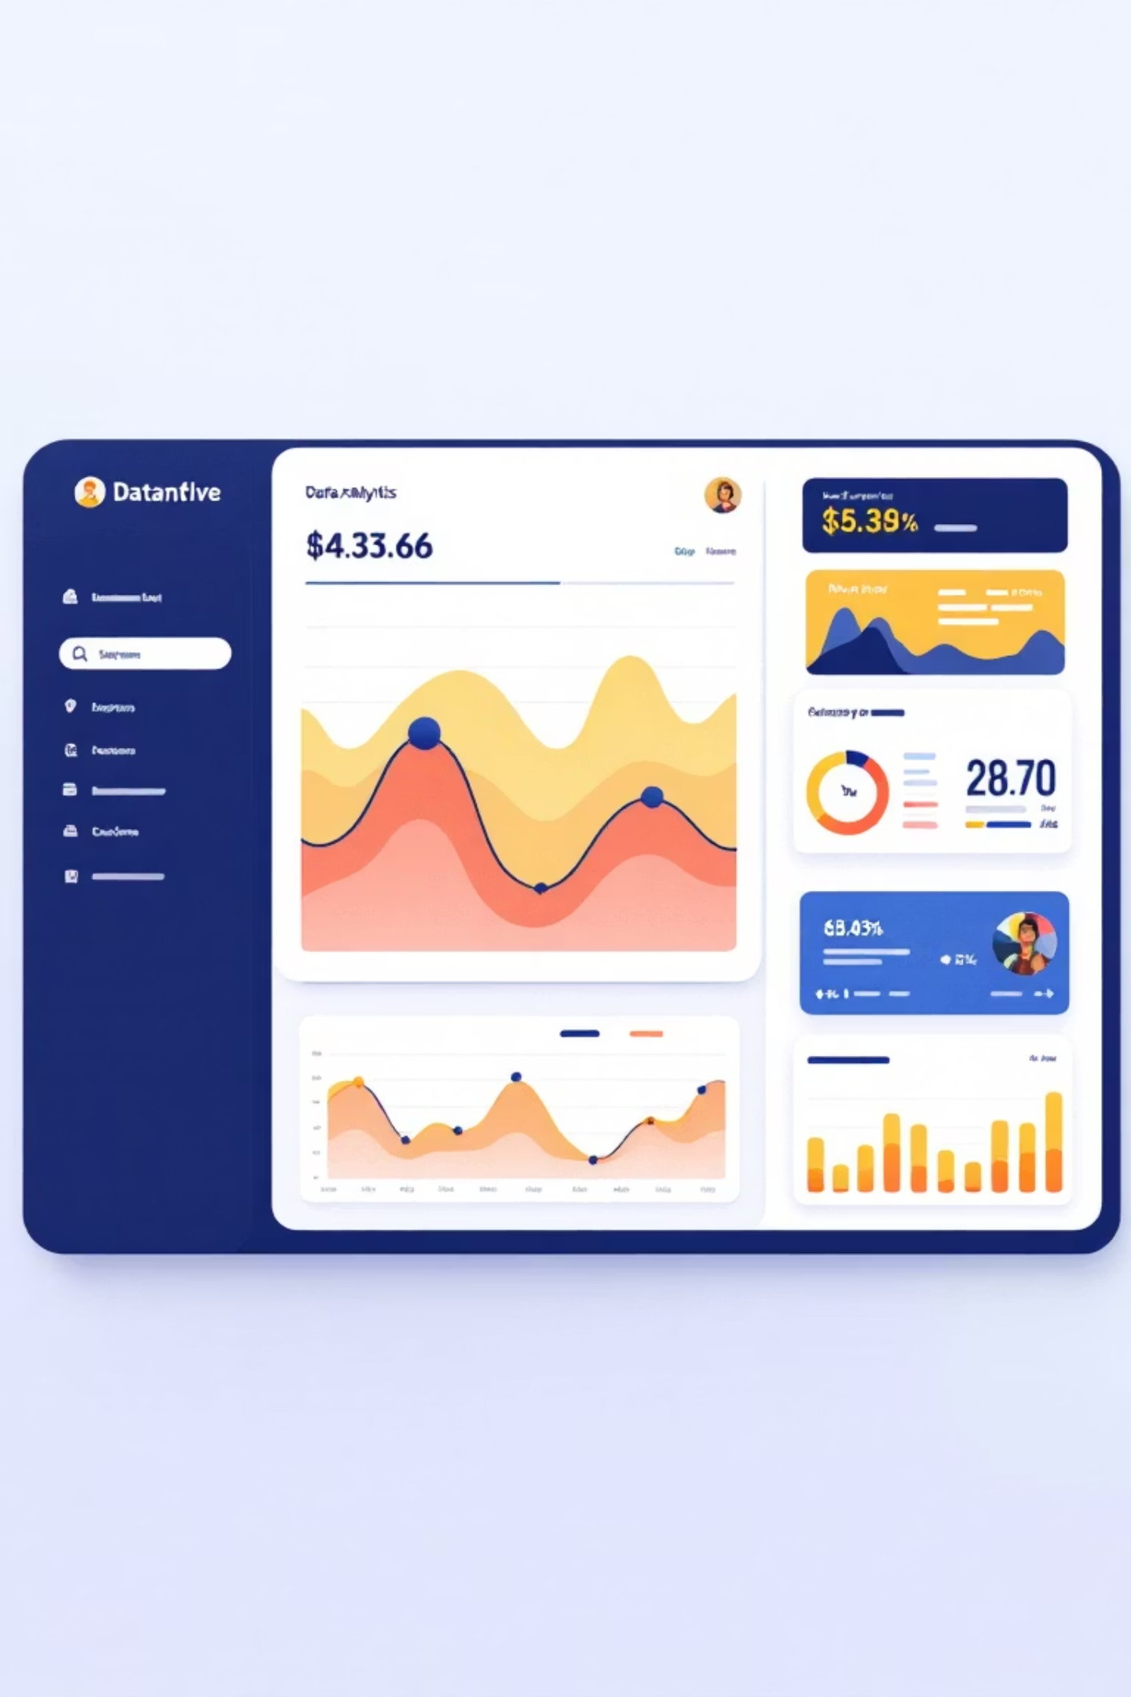
Model Performance Excellence
99.89%
3,636
19
Model Accuracy
Records Processed
Engineered Features
Exceptional R² score of 0.9989 in predicting coffee sales
Comprehensive dataset analyzed for insights
Advanced features created for prediction
The model achieved remarkable precision with RMSE of 0.0760, MAE of 0.0426, and MSE of 0.0058.

Slide 3
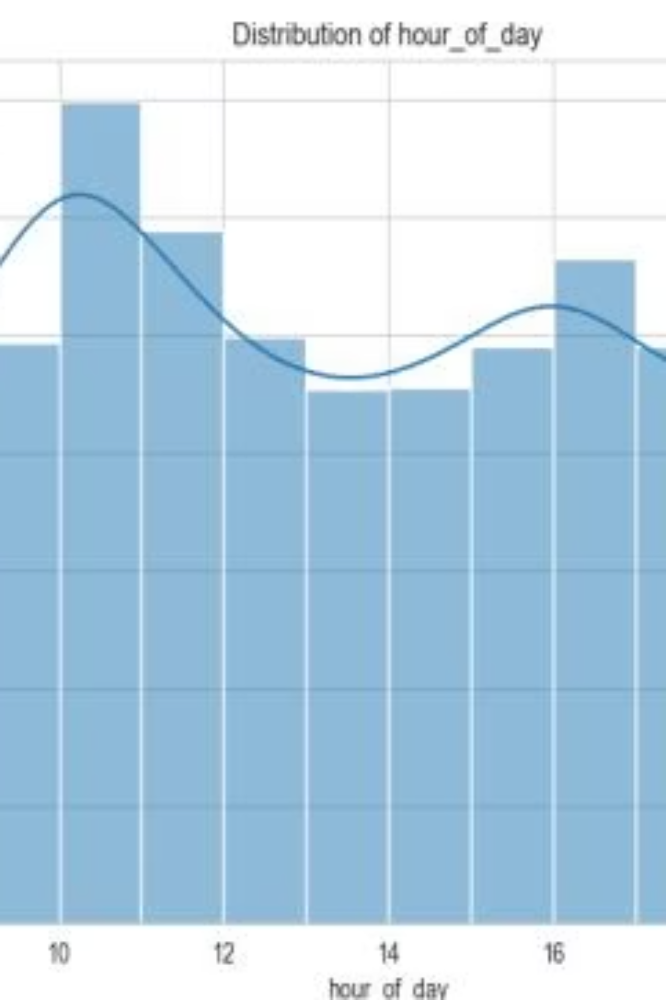
Peak Consumption Times
1
10:00 AM
Key Insight
Absolute peak with 349 sales - classic morning coffee time
Three clear peaks emerge: Morning (8-12), Afternoon (15-17), and Late evening (19-22). Hours 8-12 show the most concentrated activity, with a significant drop during lunch hours (13-14).
2
11:00 AM
Second peak with 294 sales - morning trend continues
3
4:00 PM
Third peak with 282 sales - late afternoon break
4
10:00 PM
Fourth peak with ~310 sales - surprising evening consumption

Slide 4




Time of Day Distribution
33.9%
33.6%
32.6%
Afternoon
Morning
Night
1,231 sales
1,221 sales
1,184 sales
Conclusion: Almost perfectly uniform distribution across the three time periods - no clear dominance! This indicates a diverse customer base throughout the day.

Slide 5
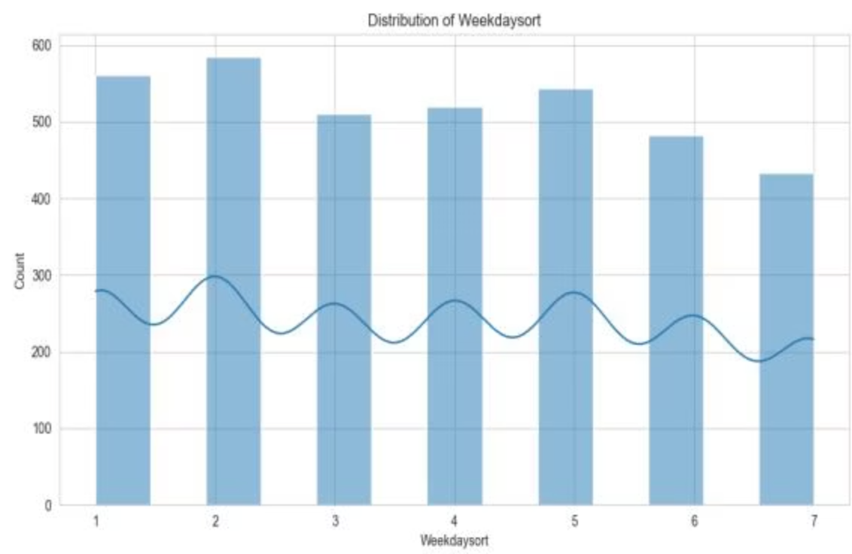
Weekly Patterns
Tuesday
Busiest day with ~580 sales
Friday
Second busiest with ~540 sales
Sunday
Quietest day with ~440 sales
Insight: Mid-week days (Tuesday-Friday) are busier than weekends, indicating a working/student customer base.

Slide 6
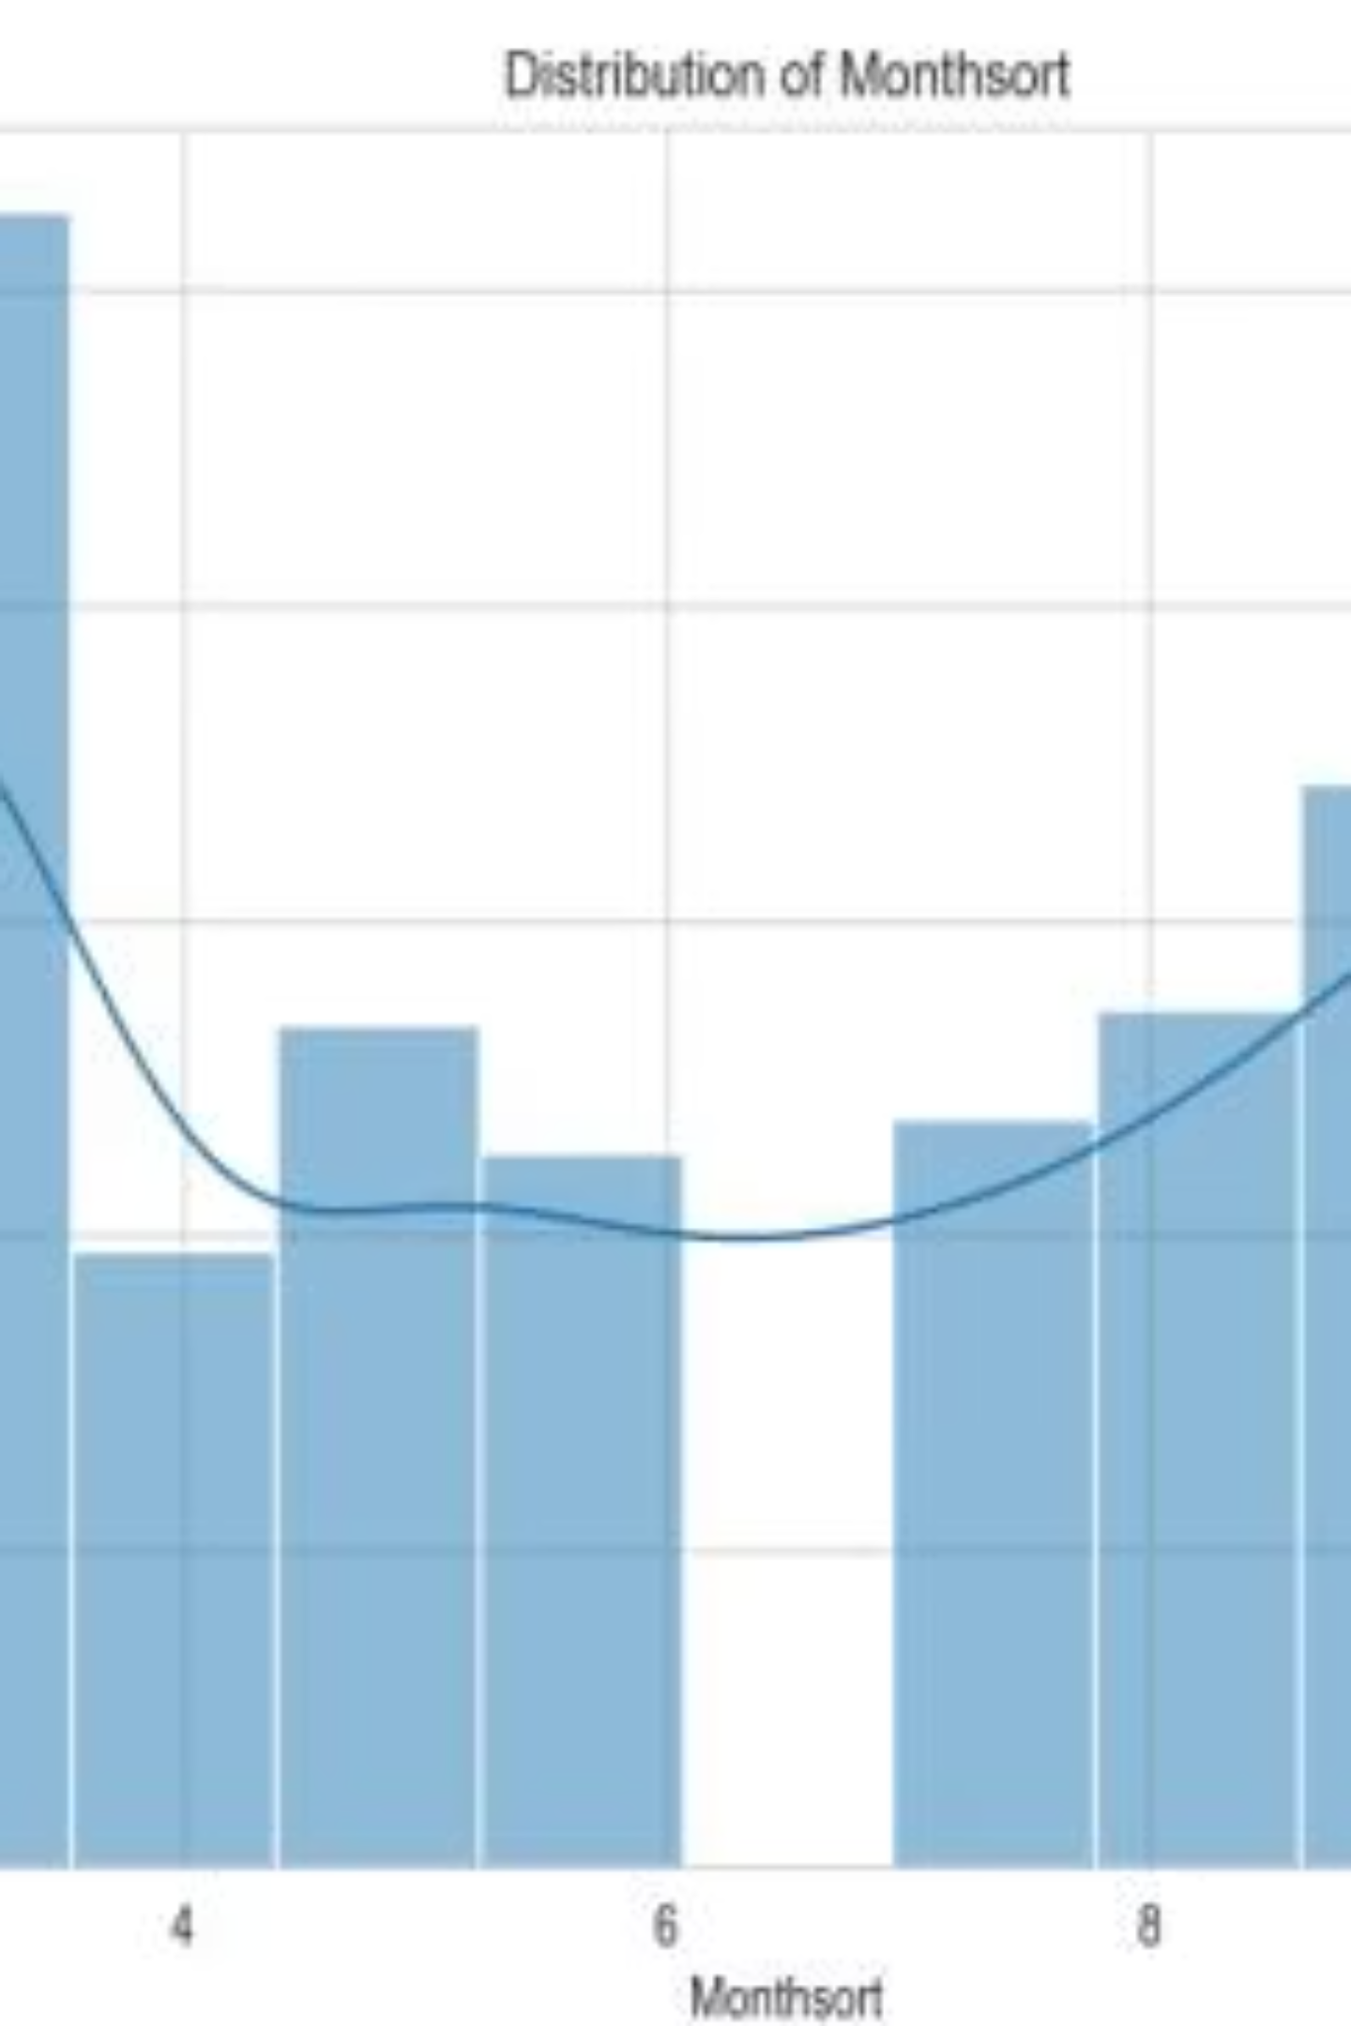
Seasonal Patterns
Spring Peak
Fall High
Summer Dip
March shows absolute peak with ~520 sales
October reaches ~420 sales
May-June are quietest months
Insight: Clear seasonality - Spring and Fall are busier, Summer is quieter (possibly due to vacations).

Slide 7
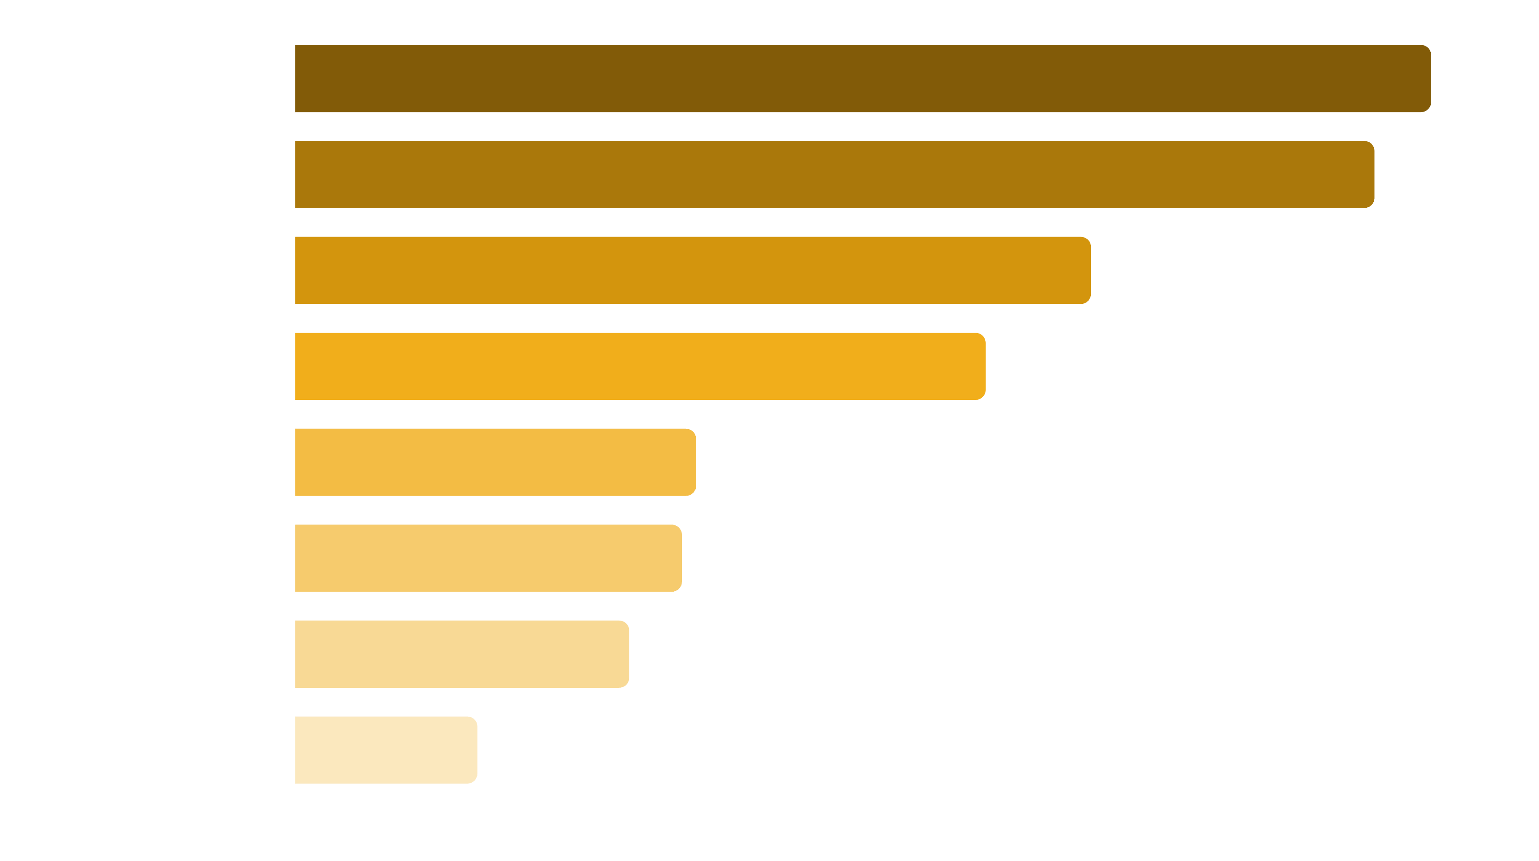

Preferred Coffee Types
Milk-Based Dominance: 72% of sales are milk-based beverages (Americano with Milk + Latte + Cappuccino). Customers prefer softer drinks over black coffee.

Slide 8


Key Business Insights
Time is Critical
Hour of day is the most important feature (30.55%) for predicting sales. Strengthen staffing during 10-11 AM and 4:00 PM peaks.
Product Strategy
Prepare larger inventory of Americano with Milk and Latte. These two products alone account for 44.2% of all sales.
Weekly Planning
Tuesday-Friday require more staff and inventory. Reduce inventory during summer months (May-June).
Evening Opportunity
10:00 PM is a significant peak time - consider extending opening hours to capture late-night customers.

Slide 9
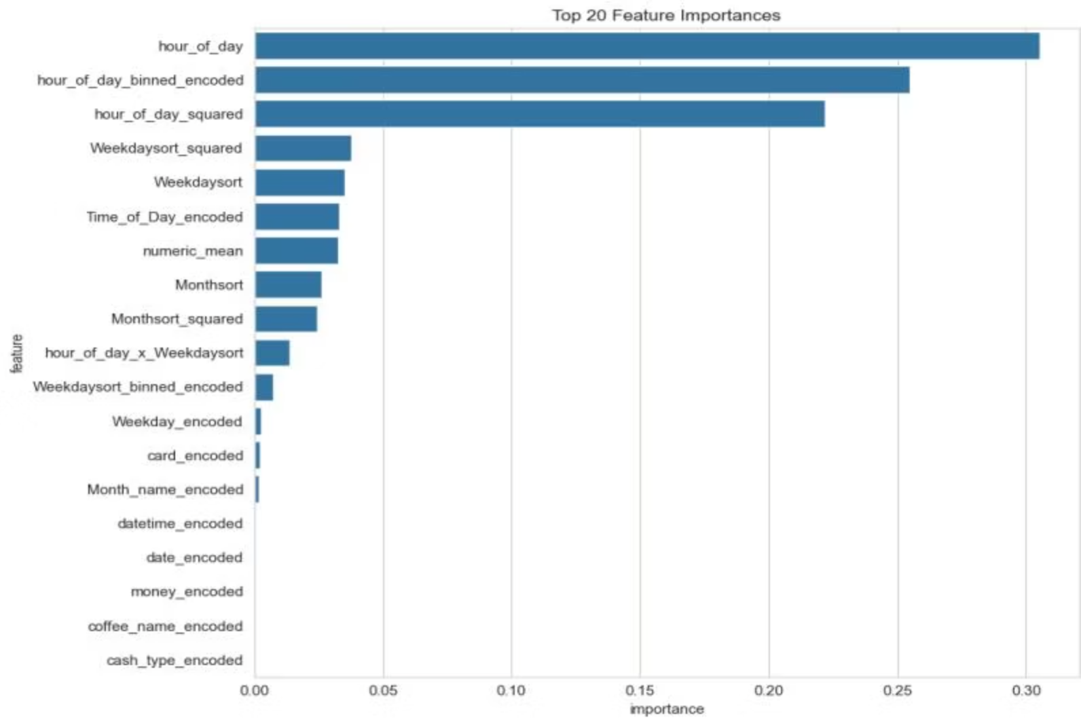
Feature Importance Analysis
Top Predictive Features
Hour of Day
30.55% importance - most critical factor
Binned Hour
25.47% importance - time groupings matter
Hour Squared
22.20% importance - non-linear time effects
Weekday Patterns
7.30% combined importance
Time-related features account for 78.22% of the model's predictive power.

Slide 10
Summary and Conclusions
Peak Times Identified
Product Preferences Clear
Weekly Patterns Defined
Three main peaks - Morning (10-11 AM), Afternoon (4 PM), and Evening (10 PM). Optimize staffing accordingly.
72% of customers prefer coffee with milk. Focus inventory on Americano with Milk and Latte.
Mid-week days are busier than weekends. Adjust operations for working/student customer base.
Seasonality Matters
Model Reliability
Spring and Fall are busy, Summer is quieter. Plan inventory and promotions seasonally.
99.89% accuracy provides highly reliable predictions for future sales planning and optimization.

